Slide 1
How Satellite Works

Slide 2
A communications satellite is a satellite located in space for the purposes of telecommunications. There are three altitude classifications for satellite orbits: LEO – Low Earth Orbit: LEO satellites orbit from 160-2000km above the earth, take approximately 1.5 hrs for a full orbit and only cover a portion of the earth’s surface, therefore requiring a network or constellation of satellites to provide global, continual coverage. Due to the proximity to Earth, LEO satellites have a lower latency (latency is the time between the moment a packet is transmitted and the moment it reaches its destination) and require less amplification for transmission.

Slide 3
MEO – Medium Earth Orbit: MEO satellites are located above LEO and below GEO satellites and typically travel in an elliptical orbit over the North and South Pole or in an equatorial orbit. These satellites are traditionally used for GPS navigation systems and are sometimes used by satellite operators for voice and data communications. MEO satellites require a constellation of satellites to provide continuous coverage. Tracking antennas are needed to maintain the link as satellites move in and out of the antenna range.

Slide 4
GEO – Geostationary Orbit: GEO satellites orbit at 35,786 km (22,282 mi) above the equator in the same direction and speed as the earth rotates on its axis. This makes it appear to the earth station as fixed in the sky. The majority of commercial communications satellites operate in this orbit; however, due to the distance from the earth there is a longer latency.

Slide 5
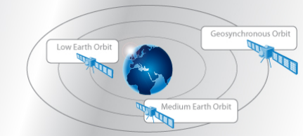
Figure 1. Satellite Orbits

